Slide 1
Data Program
End User Introduction
DELI-GEN-PRE-DAPG-003-A2

Slide 2
Versioning follow-up
Index | Date | Main changes | Proposed by | Reviewed by | Validated by
A0 | 04/12/2023 | First Issue | P. BRET | C. VANEENOGE O. VERMONT | D. DESMONS C. PERSOZ
A1 | 19/06/2024 | Updates with examples, switch to English | A.COIGNET | C. VANEENOGE P.BRET | D. DESMONS C. PERSOZ
A2 |  | Updates to the data product exemples | P.BRET
Yellow = updates since release A1 (19/06/2024)

Slide 3
Agenda
The Data Program provides access to data to business
The Data Program enables to customize by entity based on trustworthy source
Who are the Data Program stakeholders ?
The Data Program is already bringing value to the VINCI Construction entities that use it.
What's the latest on the Data Program ?

Slide 4
The Data Program provides access to data to business
What is Data Program ?
Big Bets
Big Bets
Big Bets
Big Bets
Data as
a product
Business
Ownership
Self-service
platform
Federated
governance
Give access to coherent data under different format, as reports or as raw data for self- service reporting or even AI.
For each data product a business sponsor is defined, this sponsor is the Data Owner. The Data Owner makes decisions on the data product with the help of an IT referent (Data Steward)
.The Data Program simplifies the discovery, search, and understanding of data through the Data Marketplace, the « Amazon of data ». Users can see existing data, quality metrics and request access.
Responsibility must be distributed across business entity & domains, as close to the business as possible.
Goal : Decentralize data by domain / business entity

Slide 5
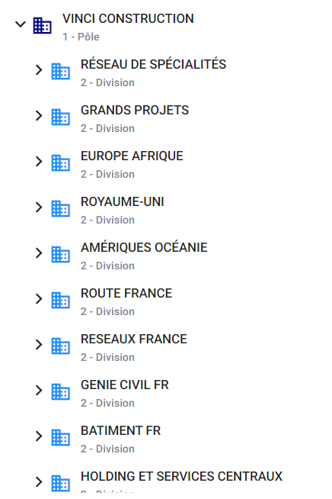
1.1 Example of a source data product
Big Bets
Data as
a product
COR – Managerial organization
Need: Share a common organizational structure for BI and AI projects
Solution : Provide a common organizational structure in an appropriate format
Perimeter : Vinci Construction
Target Users : Every data Consumers
Data Product Checklist
Define : Managerial organization is a single business object. Legal organization is another data source data product.
Self-Describing : Fields are correctly named to immediately understand their meaning
Discoverable : The data product is not yet discoverable in the Data Catalog
Accessible : The data product is available in Power BI and SQL formats.
Secure : The Data owner has decided that the product will be freely available to all of VINCI-Construction.
COR – Managerial organisation

Slide 6
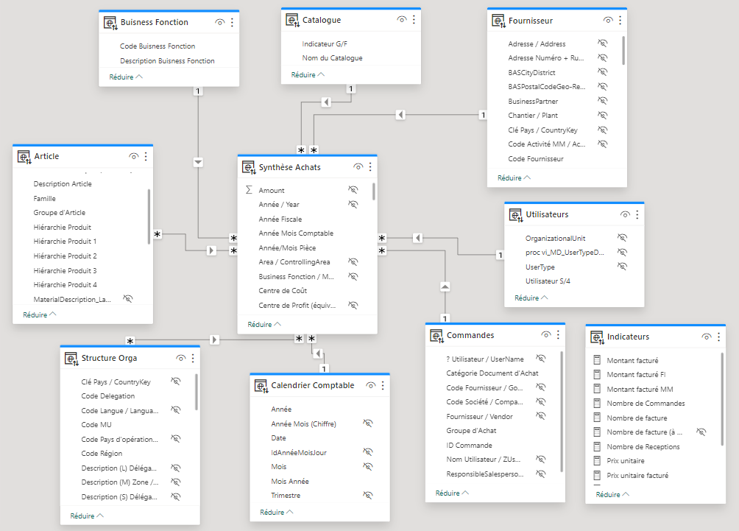
1.1 Example of a composite data product
Big Bets
Data as
a product
Order Synthesis
Need: Cross-reference delivery and invoice data (from the E-Cube PR372 report) with local data.
Solution : Add a new data consumption format in the form of a Power BI model (+ SQL)
Perimeter : E-Cube France
Target users : Purchasing referents
Order Synthesis (Invoices and Deliveries)
Data Product Checklist
Define : The dataset contains the data required for analysis (no more, no less). With one single fact table and multiple dimensions.
Self-Describing : Fields are correctly named to immediately understand their meaning
Discoverable : The data product is exposed in the Data Catalog (which groups all data products).
Accessible : The data product was already available in AFO. It is now also available in Power BI and SQL
Secure: Only authorized users can access data.
AFO : Analysis for Office, equivalent pivot tables in excel
SQL : database format

Slide 7


1.2 Business Ownership
Big Bets
Business
Ownership
Order Synthesis – an example of data managed by the business
Data Owner
Data Analyst
Data Product Business Sponsor:
Graziella ALATI- Purchasing Tools Manager
Name and define Data Product
Decide who has access to what
Arbitrate data product evolutions
Ex : Arbitration to extend the scope of the data product
Data Product IT Referent:
Clément BERTON – IT Procurement responsible
Implements Data Owner decisions
Provides access to the data product
Proposes and maintains data product documentation
Development and technical support are provided by VCSI's Data Factory, which specializes in Microsoft technologies.

Slide 8
1.2 Business Ownership
Big Bets
Business
Ownership
COR– an example of data managed by the business
Data Owner
Data Analyst
Data Product Business Sponsor:
Jean-Luc MITRY- VINCI Construction Controlling director
Name and define Data Product
Decide who has access to what
Arbitrate data product evolutions
Data Product IT Referent:
Grégory JULIER- COR IT Project lead
Implements Data Owner decisions
Provides access to the data product
Proposes and maintains data product documentation
Development and technical support are provided by VCSI's Data Factory, which specializes in Microsoft technologies.
Notes:
Trop de bullet points // Trop de texte

Slide 9
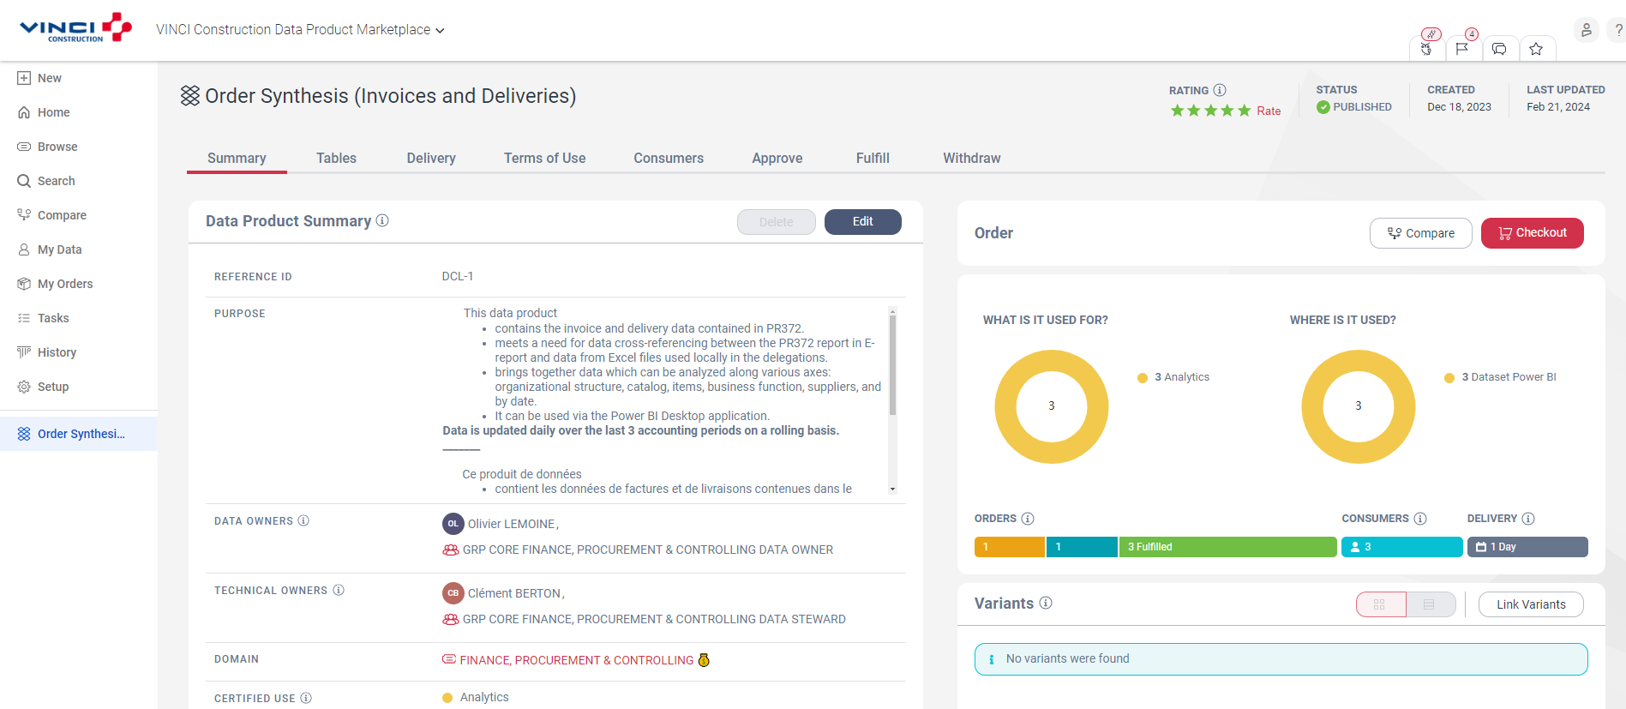
1.3 Self-Service Platform
Big Bets
Self-service
platform
Discover Data Product
Request access to the data product
Browsing and searching data products
Tables and fields in the data product
Order Synthesis data product presentation (description, data owner, data steward...)
Notes:
Juste mettre découvrir // Un seul screen de DP en grand (choisir 2/3 exemples sur chaque pilier)

Slide 10


1.4 Federated Governance
Multi-local
Federated
Centralised

Slide 11
1.4 Federated Governance
Big Bets
Federated
governance
Example of a federated managements
CENTRAL DATA PRODUCT
Data Producers
Domain Finance & Controlling
Domain Health & Safety
Domain Environment
Data Product : Organizational Structure (COR)
Data Owner: Jean-Luc MITRY
Data Analyst: Grégory JULIER
Data Factory: Sandra SORET
Data Product :Inspections, Visits and Audits (E-Care)
Data Owner : Regis AMBERNI
Data Analyst : Maximilien HEPP
Data Factory : Dominique POLVERELLI
Data Product : Emissions Consolidated (KPI Environment)
Data Owner : Lorène DUMEAUX
Data Analyst : Nizar CHAFII
Dara Factory : Sandra SORET
Based on central data
Based on central data
Based on central data
LOCAL DATA PRODUCT
Data Producers
Specialty Networks
Building France
VCEA - Germany
Data Product : SN Emissions (Be Safe)
Data Owner : Juliette LECHARD (TBC)
Data Analyst : Mathieu COBAT
Data Factory : Mathieu COBAT
Data Product : V-Achats
Data Owner : Karim SEMGHOUNI
Data Analyst : David VINCENT
Data Product : PRIS List
Data Owner : Gerd BREMBACH
Data Analyst : Gerd BREMBACH
Data Factory : Sandra SORET
Based on central data

Slide 12



2. The Data Program enables to customize by entity based on trustworthy source
What is the purpose of the Data Program?
Reuse & Customize
A trustworthy source
Use A.I
The Data Program makes it easy to reuse existing data products.
It gives consumers the means to create their own analysis or customize existing one by adding local data.
The Data Program ensures:
1. A single source of truth via common repositories
2. Quality data thanks to rules, monitoring and managers.
The Data Program makes reliable data available, which is a prerequisite for extracting the full value of AI at VC.
(coming soon)

Slide 13
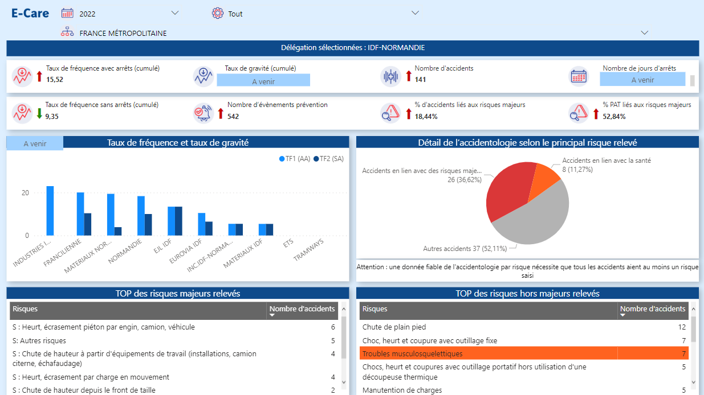
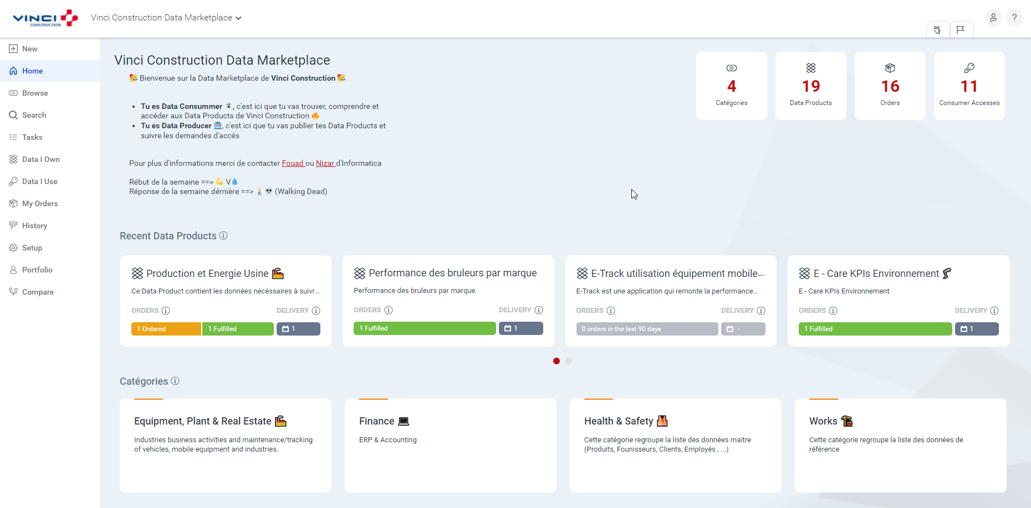
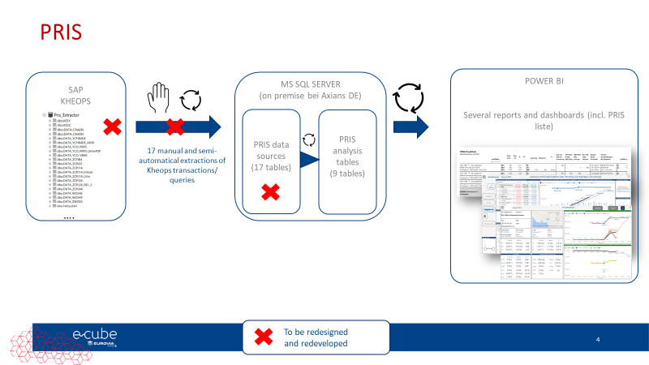
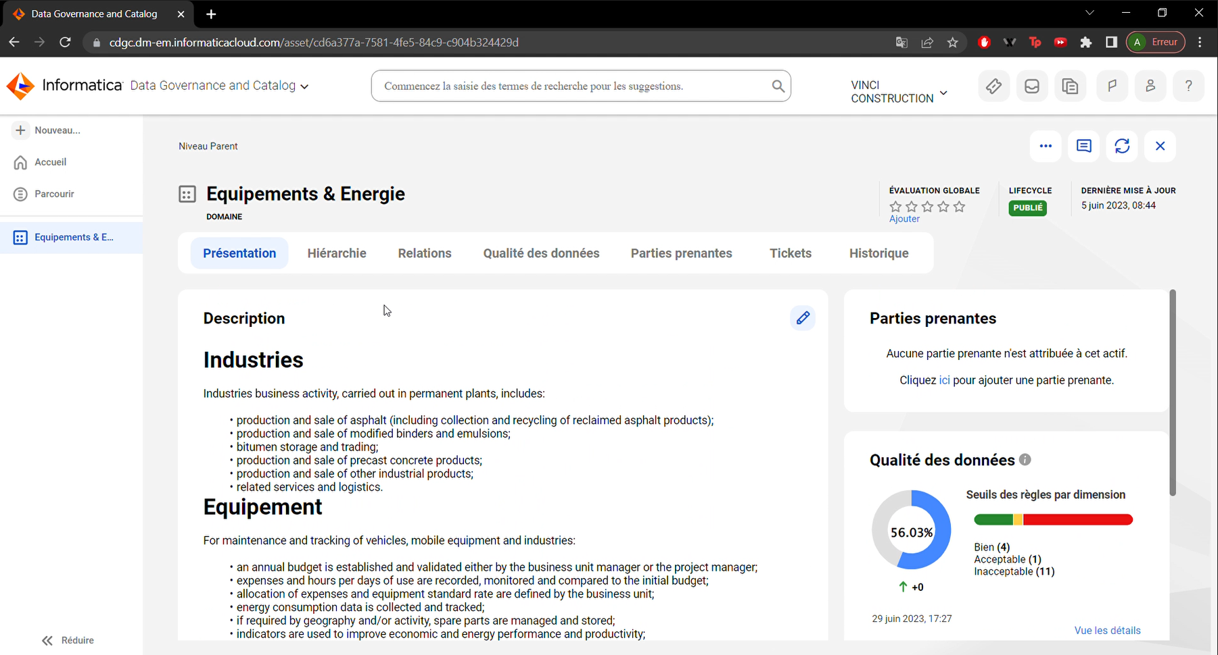
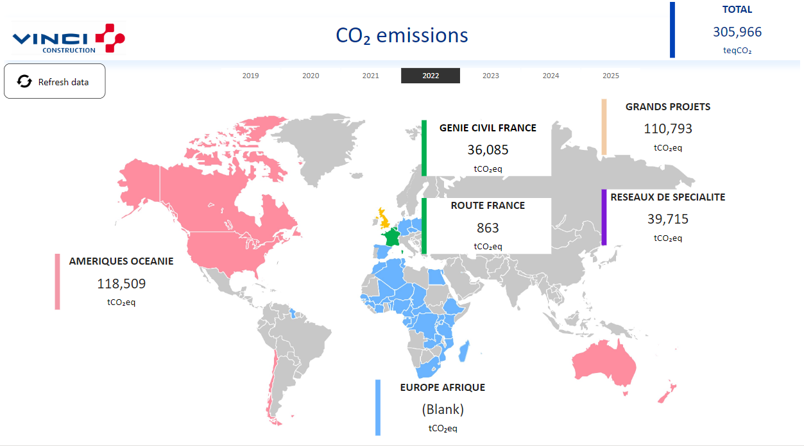
4. The Data Program is already bringing value to the VINCI Construction entities that use it.
Achievements since launch
Structuring actions in progress
Data Catalog
To update
Data Marketplace
Use cases
E-Care Reporting : Deployed on Route France (March 23)
Pris : Deployed on Germany (March 23)
Environment KPIs : MVP* completed, industrialized solution under development
E-Drive Energy : In production (Nov. 2023)
Procurement Self-service : In production (Dec 23)
E-cube Adoption : In production since mid-2022, Automation in progress
Timesheet & allowance weekly reporting: In production (XXX)
COR: In production (XXX)
Self-service platform & Governance
Governance principles
Call for tenders and POC Data Governance solutions, industrialization underway (Informatica)
Call for tenders for Data Sharing solutions
First toolbox for data products on azure
*MVP : minimum valuable product, first batch of key product features
*POC : Proof of Concept, testing a technical solution

Slide 14




Slide 15





Data consumers overview
The data consumers are the “customers” for a data product. They use, reuse and customize reports or AI models for their specific needs.
DATA CONSUMERS
Discover Data Products for their analytical activities and use them in a performant and compliant way.
Main data consumer
Business
IT
Business user
Citizen Data Analyst
Data Analyst
Data Analyst Adv
Data Engineer
Application Developer
Data Scientist
Search and use the knowledge extracted from the Data Products.
Business Users with data culture skills, non data specialists, who use Business Intelligence tools to make data analysis.
Translates information from data teams into knowledge that can be understood by business users
Provides clean, sorted and aggregated data sets for data visualization
In charge of building the analysis device and publishing the data sets. Uses the content of the data to extract analytical information.
Build applications using data from different sources
Performs classification and statistical prediction algorithms to optimize business processes.
Business skills
IT skills
EXCEL - AFO
POWER BI, SAP, SAP Analytic Cloud, …
CODE (Python, C#, ABAP, SPARK, … ), Database langage (SQL, SAP Hana, …)

